Slide 1
MOVIEVEL
Submitted by:-
Durgesh Giri

Slide 2
Objectives
The Develop response Website in using html CSS and JavaScript and create the home page, Trending page, Explore page, Movies and Favourite page.
This website is provides user essay to use and download movies in 4K and HD quality.
This website is also provides the Movie Cast and the Movie Characters & also provides Images.

Slide 3

Users
Home
Trending
Explore
Movies
Favourite

Slide 4
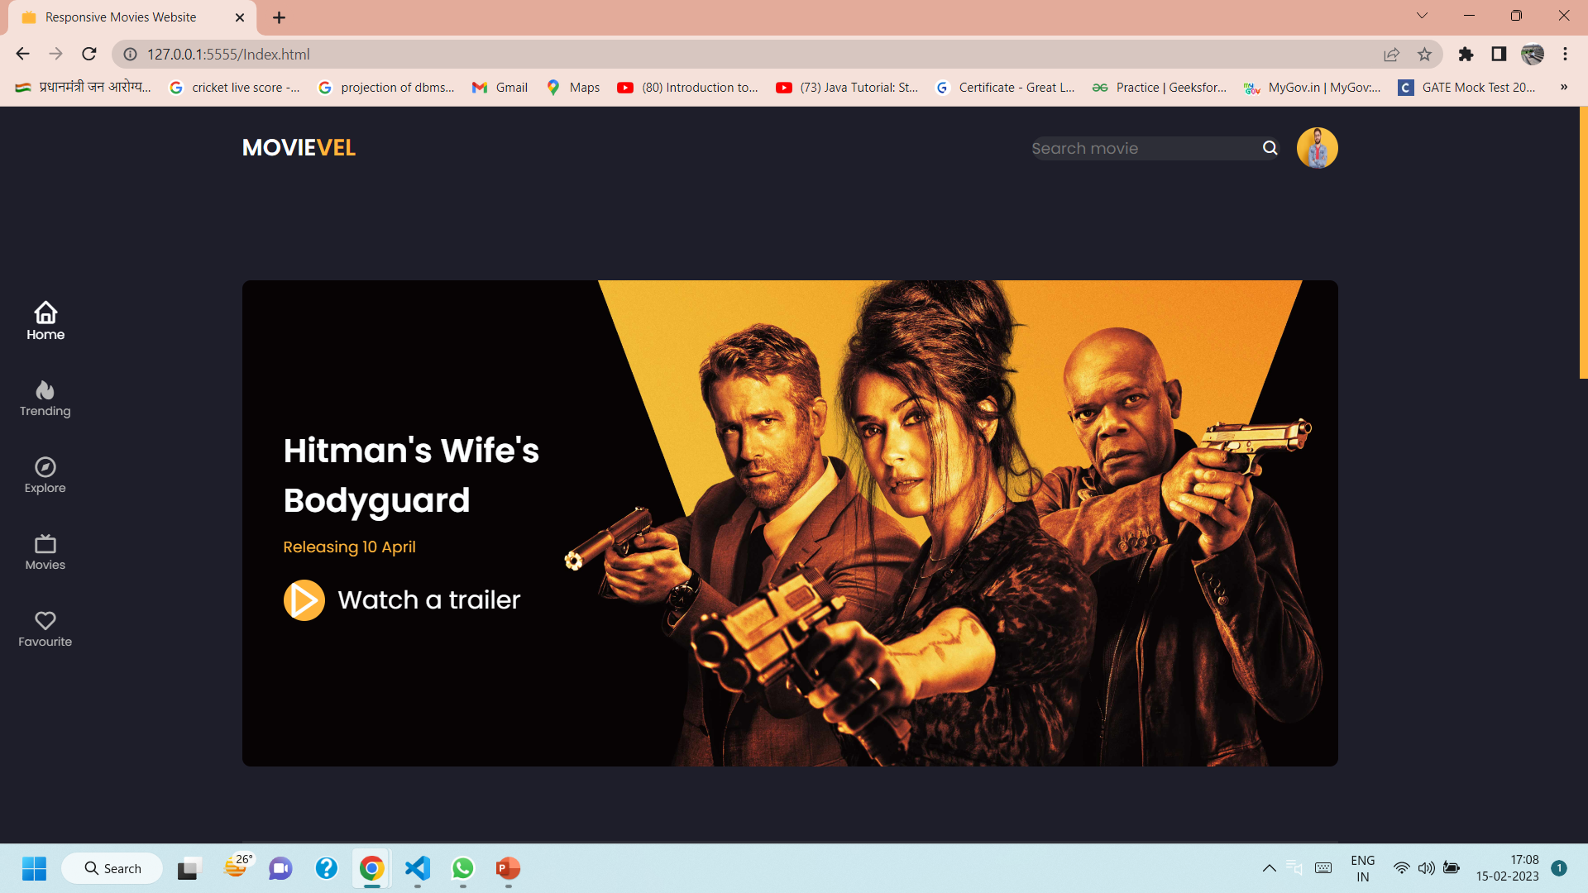
HOME PAGE

Slide 5
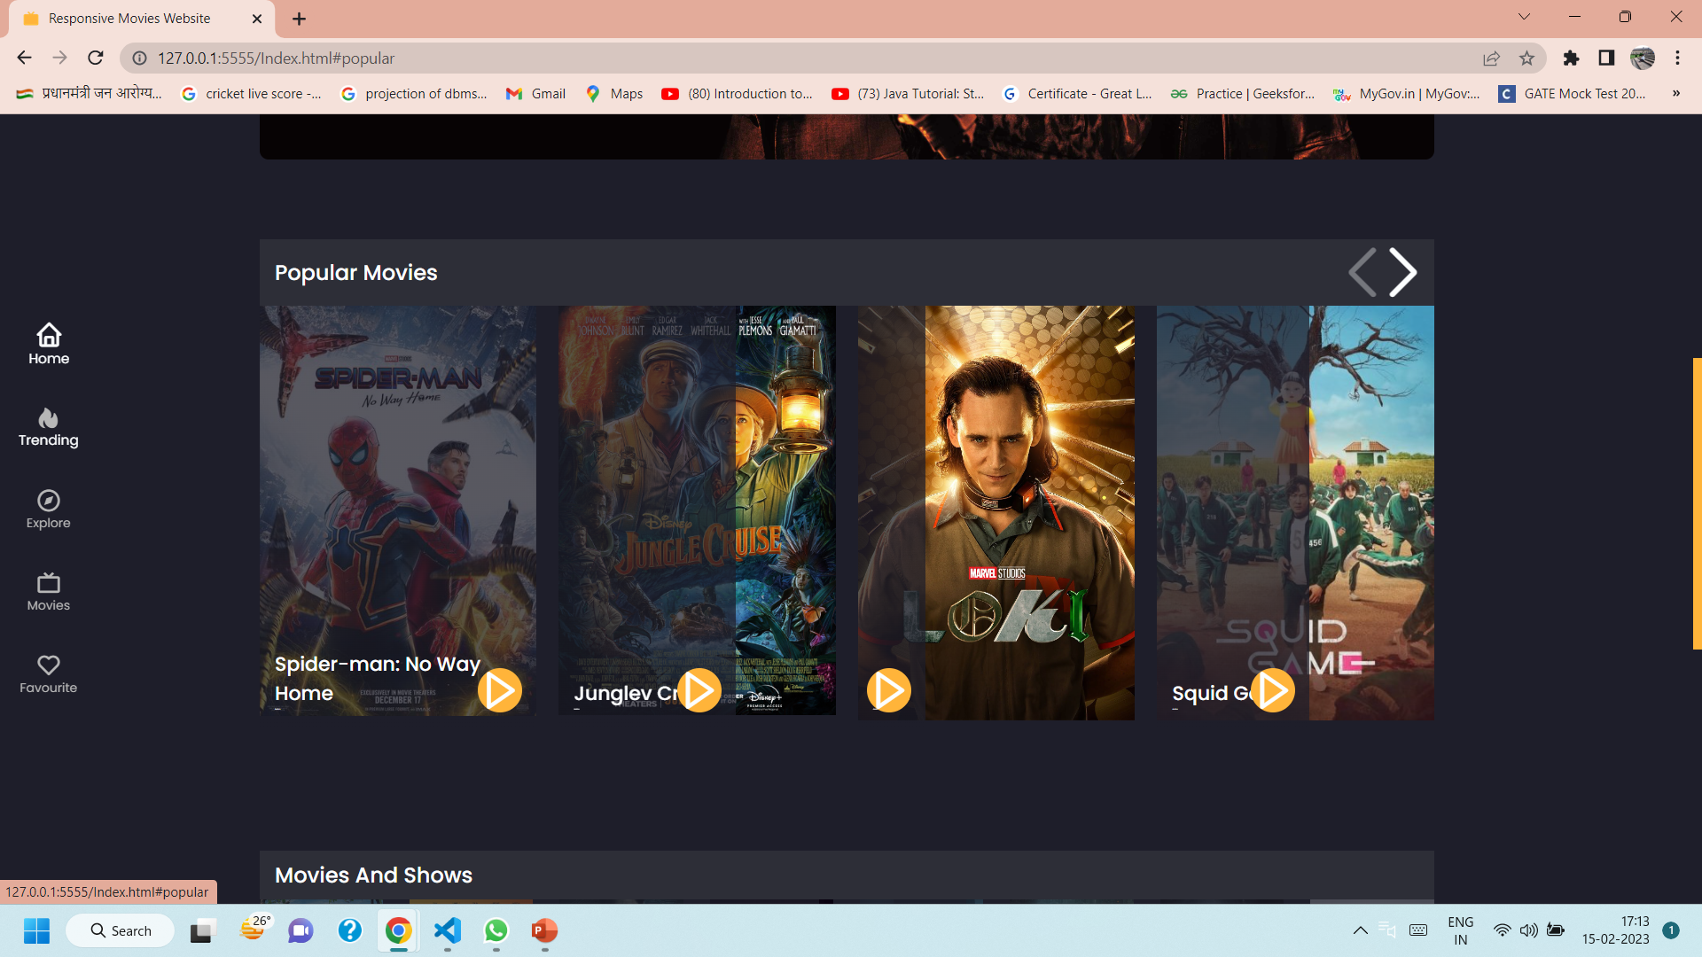
TRENDING PAGE

Slide 6
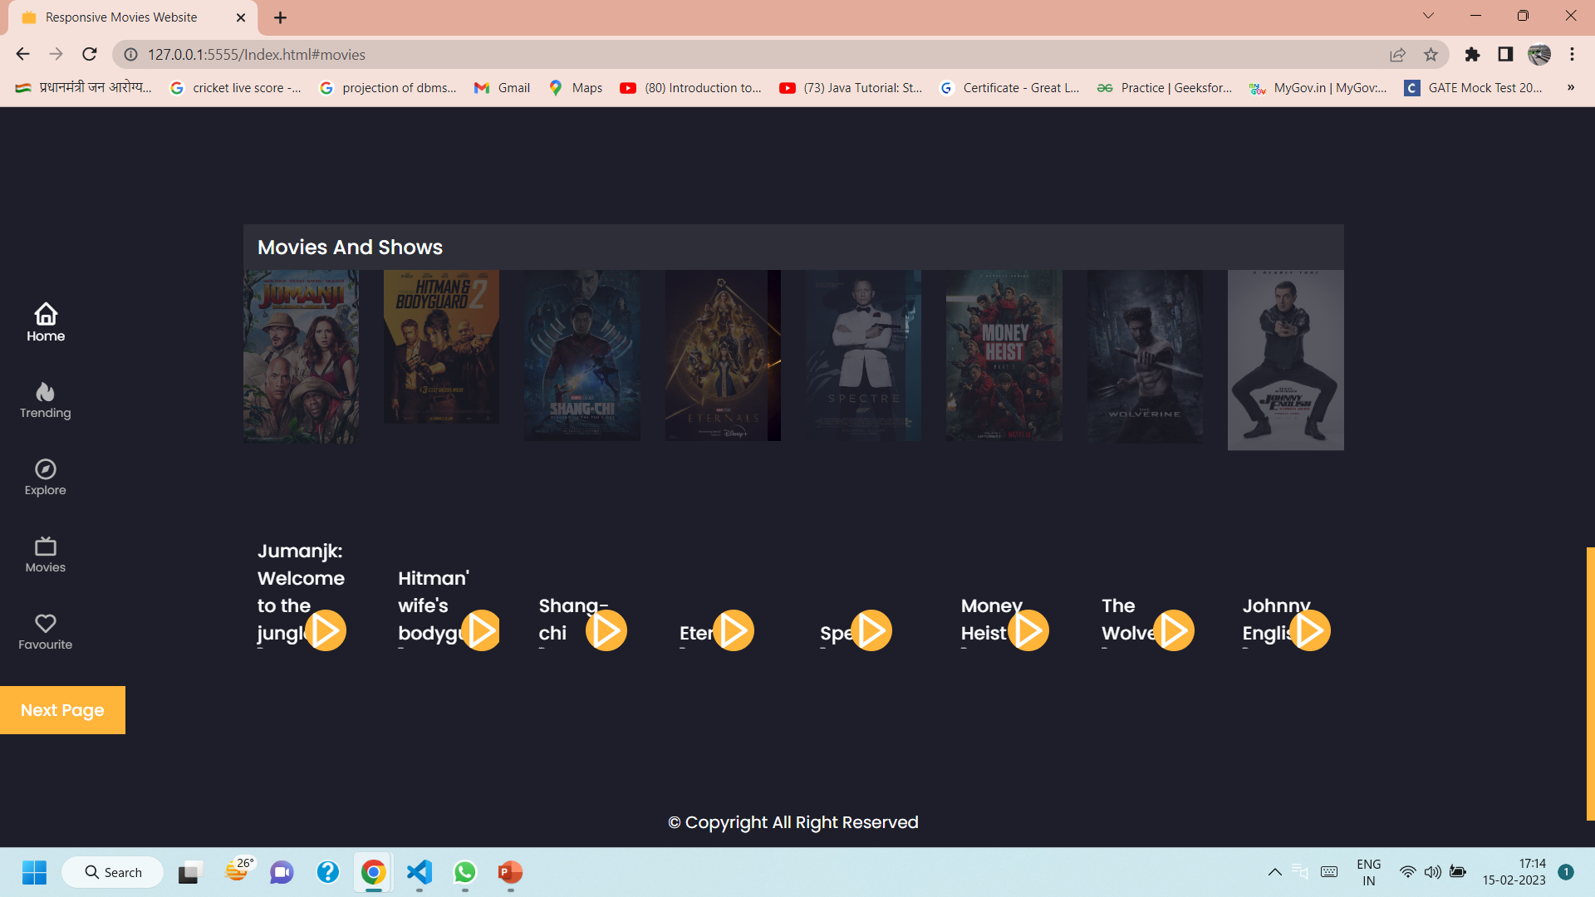
MOVIES AND SHOWS

Slide 7
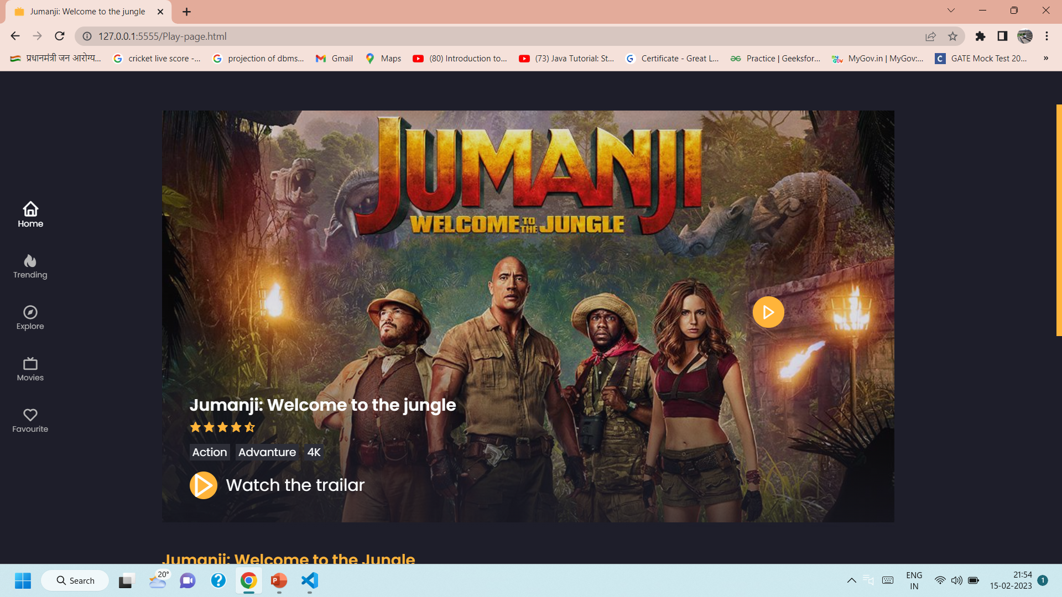
MOVIES PAGE

Slide 8
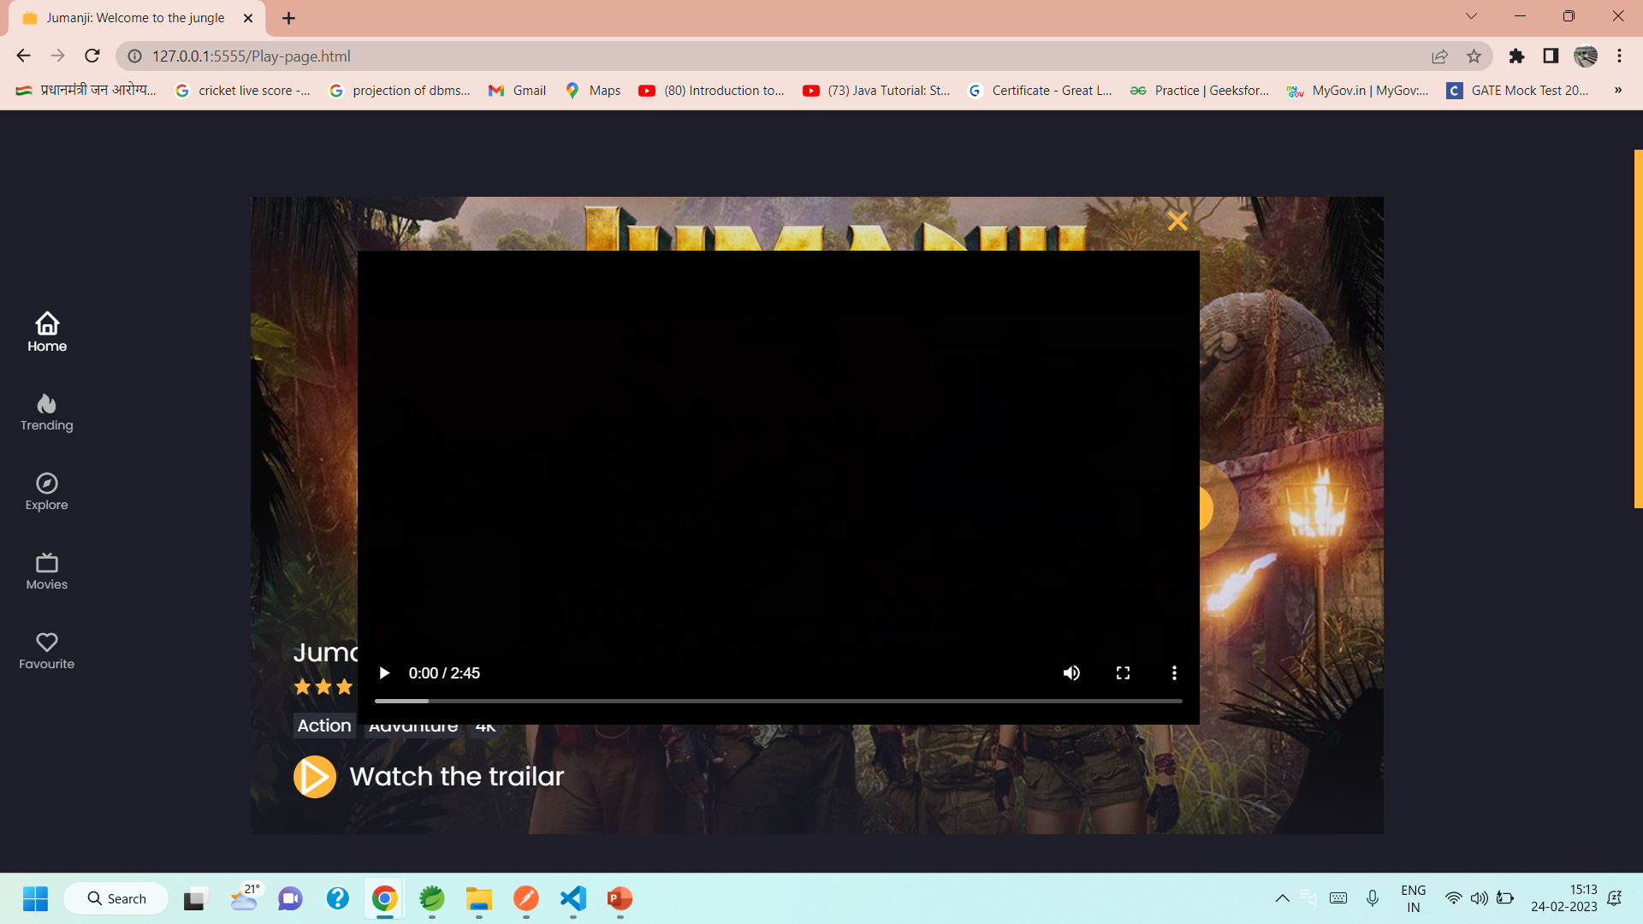
PLAY PAGE

Slide 9
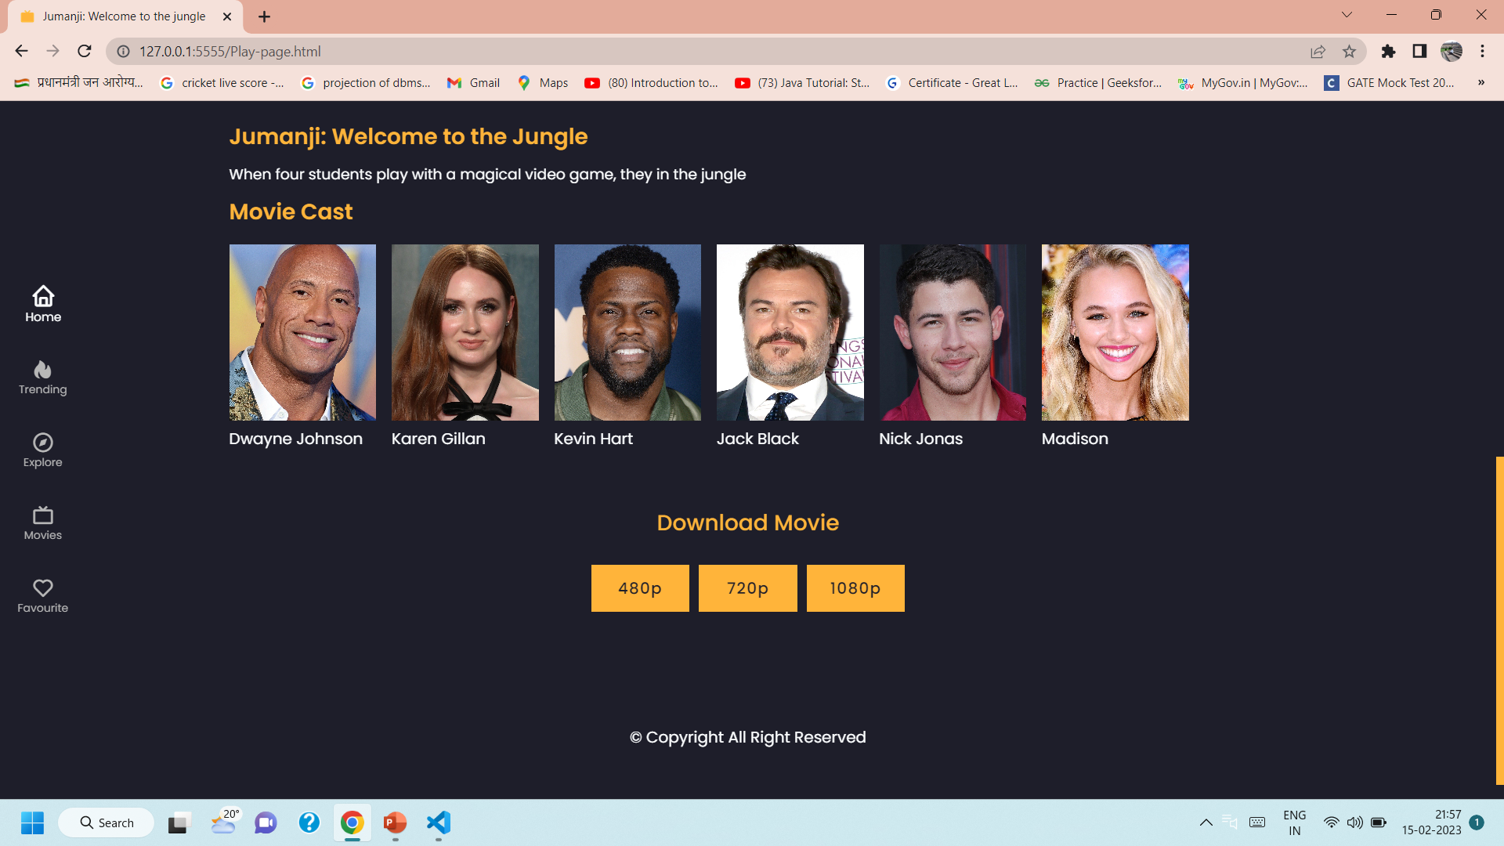
MOVIE CAST AND DOWNLOAD

Slide 10
Features
.
This website is mainly focus the Movie-cost and Movie Characters.
The Movie is download and watch the Movie Trailer in HD quality.

Slide 11
Thank You

